Slide 1
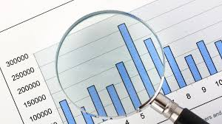
Excel charts and graphs for data presentation

Slide 2
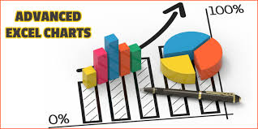
Charts
In Excel , graphs (or charts) charts are a great way to visualize data. Charts in Excel are used to represent data visually, making it easier to spot trends, comparisons, and relationships.

Slide 3


Pivot Chart
A Pivot Chart in Excel is a graphical representation of a Pivot Table. It provides an interactive way to visualize and analyze large data sets. Just like Pivot Tables, Pivot Charts allow you to filter, group, and summarize data dynamically, making it easy to identify trends and patterns.

Slide 4
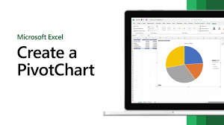
Steps to Create a Pivot Chart
Prepare Your Data
Make sure your data is well-organized in a table or range with clear headers.
Create a Pivot Table
Select your data range.
Go to the Insert tab in the Excel rib
Click PivotTable, and choose the location for the Pivot Table (new or existing worksheet).
Insert Pivot Chart
With the Pivot Table selected, go to the Insert tab.
In the Charts group, choose a chart type (e.g., Column, Bar, Line).
Excel will create the Pivot Chart based on your Pivot Table structure. on.

Slide 5
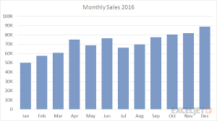
chart types
In
Go to the Home tab on the ribbon.
Column Chart
A Column Chart in Excel is one of the most common chart types used to compare values across categories by using vertical bars. It's ideal for visualizing data that shows trends or comparisons among discrete categories.

Slide 6
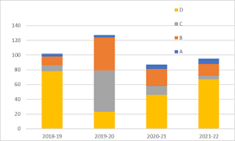
Bar Chart
A Bar Chart in Excel is similar to a Column Chart but with horizontal bars instead of vertical. It’s particularly useful when you have long category names or want to compare values across categories in a visually distinct way. Bar charts are great for making comparisons between different categories or items.

Slide 7
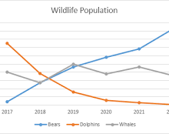
Line Chart
A Line Chart in Excel is perfect for visualizing trends over time, showing how data points change in relation to each other. Line charts are often used to track continuous data, such as sales, stock prices, or temperature changes over a period of time. The lines connect data points to emphasize the progression and fluctuations.

Slide 8
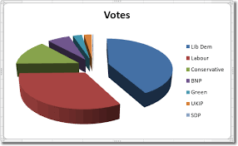
Pie Chart
A Pie Chart in Excel is used to display proportions of a whole, where each "slice" represents a category's contribution to the total. Pie charts are ideal when you want to emphasize the relative sizes of different categories.

Slide 9
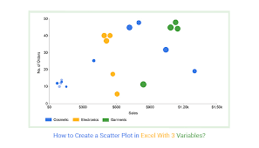
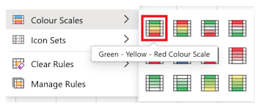
Scatter Chart
A Scatter Chart (or XY Chart) in Excel is used to display relationships between two sets of numerical data. Unlike other charts that emphasize trends, scatter charts plot individual data points based on two variables' values. This chart type is ideal for showing correlations, patterns, or clustering in data

Slide 10
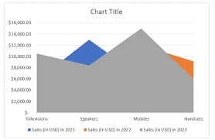
Area Chart
An Area Chart in Excel is used to display cumulative data over time, similar to a line chart but with the space beneath the line filled in with color. This type of chart is ideal for showing trends in data and how the total value evolves as new data is added.

Slide 11
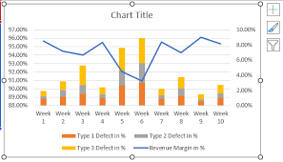
Combo Chart
A Combo Chart in Excel combines two or more chart types in a single graph to visualize different types of data within one chart. This chart type is especially useful when you have mixed data (e.g., sales volume and profit margins) and want to compare them on the same chart but with different chart types (e.g., a column chart for sales and a line chart for profit margin).

Slide 12
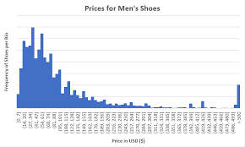
Histogram
A Histogram in Excel is a type of column chart that displays the frequency distribution of a set of data points. It shows how often values fall within certain ranges (called "bins"). Histograms are ideal for visualizing the distribution of numerical data and identifying patterns such as skewness, kurtosis, and outliers.

Slide 13
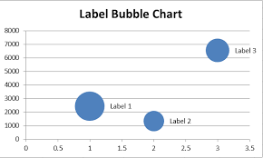
Bubble Chart
A Bubble Chart in Excel is used to display three dimensions of data in a single chart. It’s similar to a scatter plot but with the added dimension of the bubble size, which represents a third variable. This chart is great for visualizing the relationship between multiple variables and identifying patterns or correlations.

Slide 14
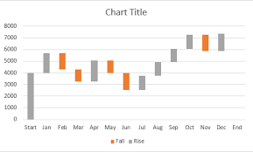
Waterfall Chart
A Waterfall Chart in Excel is used to show how an initial value increases and decreases through a series of intermediate values, ultimately arriving at a final value. It's useful for visualizing financial data, such as net income or profit, or tracking changes in values over time. Waterfall charts clearly display positive and negative contributions, making it easier to analyze how each factor affects the total.

Slide 15
Conclusion
Charts in Excel offer numerous advantages for visualizing and analyzing data including data visualization, better decision-making, quick comparisons, clarity in reporting, efficient data exploration, identification of patterns and outliers, forecasting, and predictive analysis.

Slide 16

Thank you !!!
ajaycraju98@gmail.com

